Slide 1
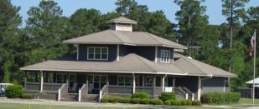
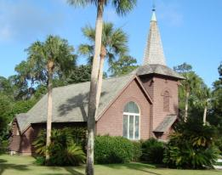
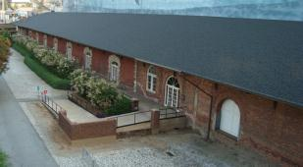
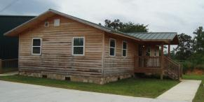
DOAS Insurance Service Office
(ISO)
Building Classifications

Slide 2
ISO Building Classifications
Building Construction has been used as part of the
insurance rating factor for over 100 years.
ISO has developed a system of classification for buildings.
This system is made up of six categories:
Class 1 – Frame
Class 2 – Joisted Masonry
Class 3 – Non-combustible
Class 4 – Masonry Non-combustible
Class 5 – Modified Fire Resistive
Class 6 – Fire Resistive

Slide 3
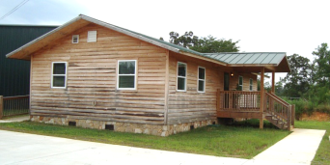
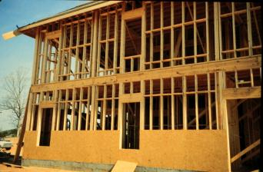
Frame Construction
Buildings with exterior walls, floors, & roofs of combustible construction; or buildings with exterior walls of non-combustible or slow-burning construction with combustible floors and roofs.
Frame buildings generally have roofs, floors, and supports of combustible material; usually wood, and combustible interior walls.

Slide 4
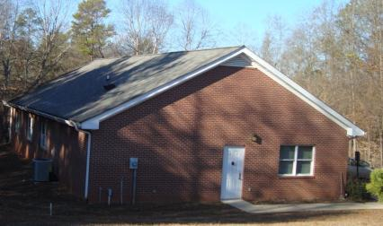
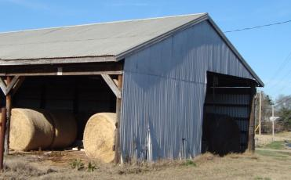
FRAME CONSTRUCTION – Exterior coatings do not change the construction class (for example: brick veneer, metal clad).
Building is being held up
by 2” x 4” wood studs,
wood roof and wood floors.
Brick Veneer is a siding that
does not provide any
structural support.
Building being held up
by wood frame.
Metal siding does
provide structural support.

Slide 5
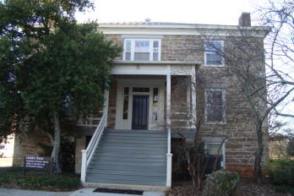
Joisted Masonry
Buildings with exterior walls of masonry or fire-resistive material
(e.g.: adobe, brick, concrete, gypsum block, hollow concrete block, stone, tile, or similar materials) rated for not less than 1 hour and with combustible floors and roofs.

Slide 6
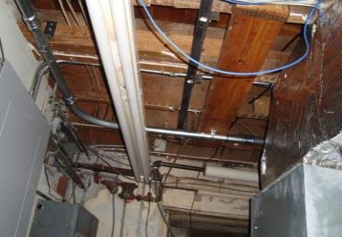
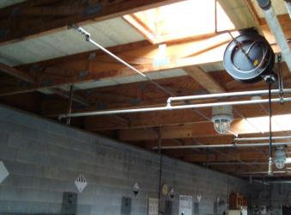
Joisted Masonry
Wood joisted floors
supported by masonry walls
Wood joisted roof
supported by masonry
(cinder block) walls

Slide 7
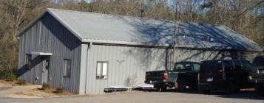
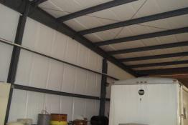
Non-Combustible
Buildings with exterior walls, floors, and roofs of noncombustible or slow-burning materials;
Building supports of non-combustible or slow-burning materials;
Non-combustible or slow-burning roof decks on non-combustible or slow-burning supports regardless of the type of insulation on the roof surface.

Slide 8
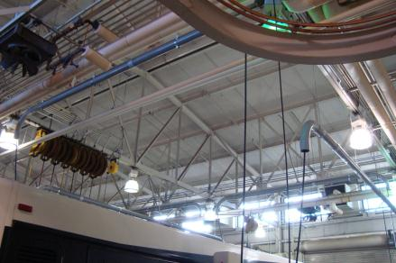
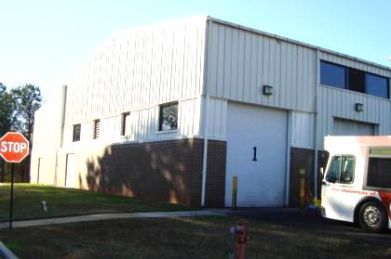
Non-Combustible
Building roof
supported by
metal trusses.
Building Class does not
change because of
exterior covering.

Slide 9
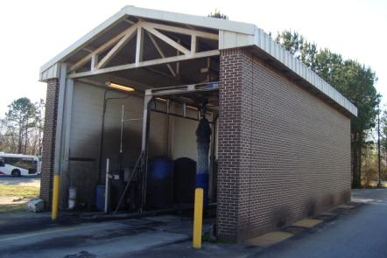
Masonry Non-Combustible
Buildings with exterior walls of masonry — not less than four inches thick; or
Buildings with exterior walls of fire-resistive construction — with a rating of not less than one hour, and
Non-combustible or slow-burning floors and roofs — regardless of the type of insulation on the roof surface.

Slide 10
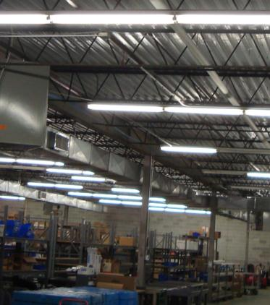
Masonry Non-Combustible
Metal roof support and
metal roof in this case,
with masonry walls.
Masonry walls.

Slide 11
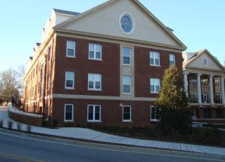
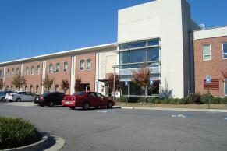
Modified Fire Resistive
Buildings with exterior walls, floors, and roofs of masonry materials between four and eight inches thick; or
Fire-resistive materials with a fire-resistance rating less than two hours but not less than one hour.
The exterior bearing walls and load-bearing portions of the exterior walls must be of non-combustible materials or of masonry, but exterior nonbearing walls and wall panels may be slow-burning, combustible, or with no fire-resistance rating..

Slide 12
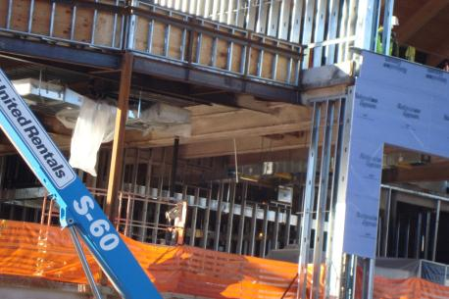
Modified Fire Resistive
Building is supported
by steel frame.
To get Modified
Fire Resistive class
metal frame must
be protected.

Slide 13
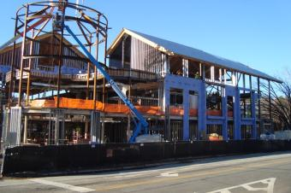
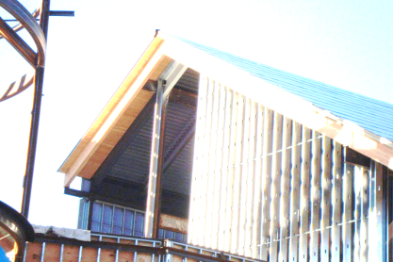
Modified Fire Resistive
Building is supported
by steel frame.
Walls will be covered
with brick veneer.
This will not change the
building classification.
Building has a
metal frame roof.
The wood trim
does not provide
structural support.

Slide 14
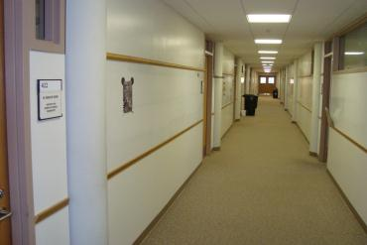
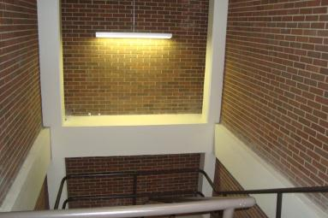
Masonry supports
Fire Resistive
Walls
Solid masonry, including reinforced concrete not less than four inches thick;
Hollow masonry not less than 12 inches thick;
Hollow masonry less than 12 inches thick, but not less than eight inches thick with a listed fire-resistance rating of not less than two hours.
Masonry supports

Slide 15
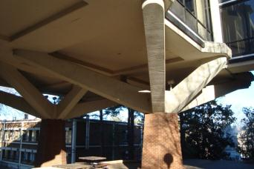
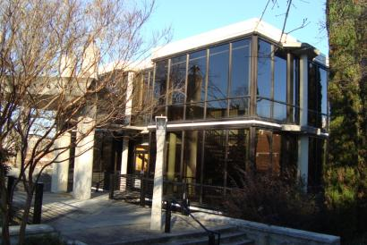
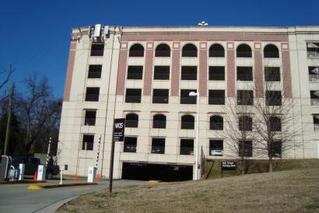
Fire Resistive (cont’d)
The exterior bearing walls and load-bearing portions of exterior walls must be of non-combustible materials or of masonry; but exterior nonbearing walls and wall panels may be slow burning, combustible, or with no fire-resistance rating.
l

